Slide 1

Introduction to DNA Structure -
Molecular biology

Slide 2
The Discovery of DNA Double Helix is One of the Greatest Findings of all time, But it’s also one of the most controversial

Slide 3
Section 2: General Biotechnology
Biochemistry: Biomolecules-structure and functions; Biological membranes, structure, action potential and transport processes; Enzymes- classification, kinetics and mechanism of action; Basic concepts and designs of metabolism (carbohydrates, lipids, amino acids and nucleic acids) photosynthesis, respiration and electron transport chain; Bioenergetics (Biochemistry by Lubert Stryer or Lehninger Principles of Biochemistry or Biochemistry - Christopher K.Matthews)
Microbiology: Viruses- structure and classification; Microbial classification and diversity(bacterial, algal and fungal); Methods in microbiology; Microbial growth and nutrition; Aerobic and anaerobic respiration; Nitrogen fixation; Microbial diseases and host-pathogen interaction (Microbiology by pelczar or Prescott's Microbiology)
Cell Biology: Prokaryotic and eukaryotic cell structure; Cell cycle and cell growth control; Cell-Cell communication, Cell signaling and signal transduction (Molecular biology of the cell - Bruce Alberts or or Cell Biology: De Roberties.)
Biotechnology- A problem approach by USHA MINA ,PRANAV KUMAR

Slide 4
Molecular Biology and Genetics: Molecular structure of genes and chromosomes; Mutations and mutagenesis; Nucleic acid replication, transcription, translation and their regulatory mechanisms in prokaryotes and eukaryotes; Mendelian inheritance; Gene interaction; Complementation; Linkage, recombination and chromosome mapping; Extra chromosomal inheritance; Microbial genetics (plasmids, transformation, transduction, conjugation); Horizontal gene transfer and Transposable elements; RNA interference; DNA damage and repair; Chromosomal variation; Molecular basis of genetic diseases (Principles Of Genetics 8th Edition by Eldon John Gardner, Michael J. Simmons, Peter Snustad and Biochemistry by Lubert Stryer)
Analytical Techniques: Principles of microscopy-light, electron, fluorescent and confocal; Centrifugation- high speed and ultra; Principles of spectroscopy-UV, visible, CD, IR, FTIR, Raman, MS,NMR; Principles of chromatography- ion exchange, gel filtration, hydrophobic interaction, affinity, GC,HPLC, FPLC; Electrophoresis; Microarray (Handbook of Instrumental Techniques for Analytical Chemistry" by Frank Settle / Instrumental Methods of Analysis by Skoog, Holler & Crouch)
PROCESS BIOTECHNOLOGY - Process Biotechnology Fundamentals by S. N Mukhopadhyay

Slide 5
Immunology: History of Immunology; Innate, humoral and cell mediated immunity; Antigen; Antibody structure and function; Molecular basis of antibody diversity; Synthesis of antibody and secretion; Antigen-antibody reaction; Complement; Primary and secondary lymphoid organ; B and T cells and macrophages; Major histocompatibility complex (MHC); Antigen processing and presentation; Polyclonal and monoclonal antibody; Regulation of immune response; Immune tolerance; Hypersensitivity; Autoimmunity; Graft versus host reaction (Immunology by Kuby).

Slide 6
Bioinformatics: Major bioinformatic resources and search tools; Sequence and structure databases; Sequence analysis (biomolecular sequence file formats, scoring matrices, sequence alignment, phylogeny);Data mining and analytical tools for genomic and proteomic studies; Molecular dynamics and simulations (basic concepts including force fields, protein-protein, protein-nucleic acid, protein-ligand interaction) (Introduction to Bioinformatics 3rd edition by Arthur M. Lesk)
Section 3: Recombinant DNA Technology
Restriction and modification enzymes; Vectors; plasmid, bacteriophage and other viral vectors, cosmids, Ti plasmid, yeast artificial chromosome; mammalian and plant expression vectors; cDNA and genomic DNA library; Gene isolation, cloning and expression ; Transposons and gene targeting; DNA labeling; DNA sequencing; Polymerase chain reactions; DNA fingerprinting; Southern and northern blotting; In-situ hybridization; RAPD, RFLP; Site-directed mutagenesis; Gene transfer technologies; Gene therapy (Gene cloning and DNA analysis by T.A.Brown).

Slide 7
Section 4: Plant and Animal Biotechnology
Totipotency; Regeneration of plants; Plant growth regulators and elicitors; Tissue culture and Cell suspension culture system: methodology, kinetics of growth and, nutrient optimization; Production of secondary metabolites by plant suspension cultures; Hairy root culture; transgenic plants; Plant products of industrial importance
Animal cell culture; media composition and growth conditions; Animal cell and tissue preservation; Anchorage and non-anchorage dependent cell culture; Kinetics of cell growth; Micro & macro-carrier culture; Hybridoma technology; Stem cell technology; Animal cloning; Transgenic animals (Chawla HS, Plant Biotechnology: A Practical Approach Carl Pinkert Transgenic Animal Technology: A Laboratory Handbook).

Slide 8
Section 5: Bioprocess Engineering and Process Biotechnology
Chemical engineering principles applied to biological system, Principle of reactor design, ideal and non-ideal multiphase bioreactors, mass and heat transfer; Rheology of fermentation fluids, Aeration and agitation; Media formulation and optimization; Kinetics of microbial growth, substrate utilization and product formation; Sterilization of air and media; Batch, fed-batch and continuous processes; Various types of microbial and enzyme reactors; Instrumentation control and optimization; Unit operations in solid-liquid separation and liquid-liquid extraction; Process scale-up, economics and feasibility analysis
Engineering principle of bioprocessing- Upstream production and downstream; Bioprocess design and development from lab to industrial scale; Microbial, animal and plant cell culture platforms; Production of biomass and primary/secondary metabolites; Biofuels, Bioplastics, industrial enzymes, antibiotics; Large scale production and purification of recombinant proteins; Industrial application of chromatographic and membrane based bioseparation methods; Immobilization of biocatalysts (enzymes and cells) for bioconversion processes; Bioremediation-Aerobic and anaerobic processes for stabilization of solid / liquid wastes (Bioprocess Engineering Principles by Pauline M. Doran)

Slide 9


Key Scientists Involved

Slide 10
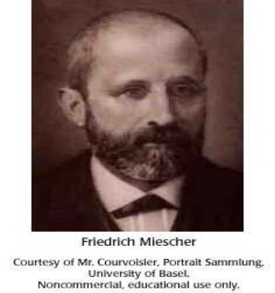
Key Scientists Involved in DNA research
In 1869 - Frederick Meischer isolates a substance from the nuclei of human white blood cells (pus) and trout sperm; calls the substance “nuclein”.

Slide 11
Key Scientists Involved in DNA research
1908 – Archibald Garrod suspected alkaptonuria patients lacked an enzyme involved in protein metabolism. Suspected a genetic defect – “inborn errors of metabolism”.

Slide 12
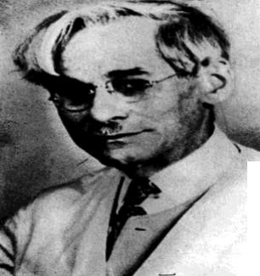
Key Scientists Involved in DNA research
Phoebus levene
Phoebus Levene, original name Fishel Aaronovich Levin, also called Phoebus Aaron Theodor Levene, Russian-born American chemist and pioneer in the study of nucleic acids
He isolated the nucleotides, the basic building blocks of the nucleic acid molecule, and in 1909
Also isolated the five-carbon sugar d-ribose from the ribonucleic acid (RNA) molecule.
Twenty years later he discovered 2-deoxyribose (a sugar derived from d-ribose by removing an oxygen atom), which is part of the deoxyribonucleic acid (DNA) molecule.

Slide 13
Key Scientists Involved in DNA research
Phoebus levene
Levene also determined how the nucleic acid components combine to form the nucleotides and how the nucleotides combine in chains.
Although the importance of the nucleic acids was unrecognized when he began his research, later discoveries showed DNA and RNA to be key elements in the maintenance of life.

Slide 14
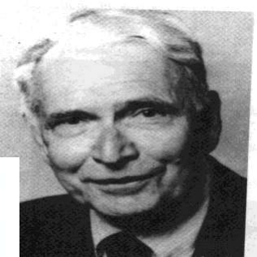
Key Scientists Involved in DNA research
Erwin Chargaff was one of those men, making two discoveries that led James Watson and Francis Crick to the double helix structure of DNA.
At first, Chargaff noticed that DNA – whether taken from a plant or animal – contained equal amounts of adenine and thymine and equal amounts of cytosine and guanine.
Chargaff Rule: A = T; G = C.
%A = %T; %G = %C
A/G = T/C; AxG = TxC
No. of Purines = Pyrimidines
Erwin Chargaff

Slide 15
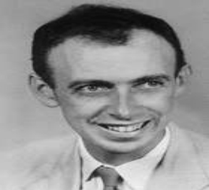
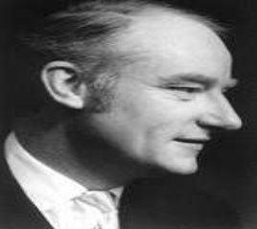
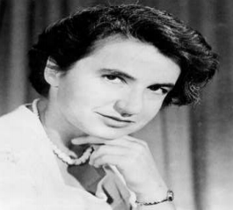
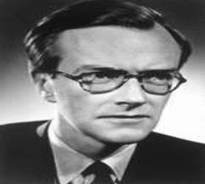
James Watson Francis Crick
Rosalind Franklin
Maurice Wilkins

Slide 16

At the end of this lecture you would be able to understand……
✓ What is DNA?
✓ DNA structure
✓ Scientific thinking before 1953
❑
Watson and Crick’s Contribution.
❑
Different forms of DNA double Helix.

Slide 17
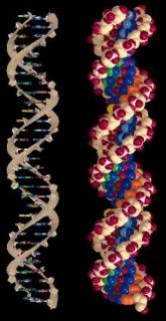
What is DNA?

Slide 18
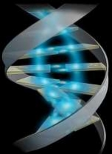
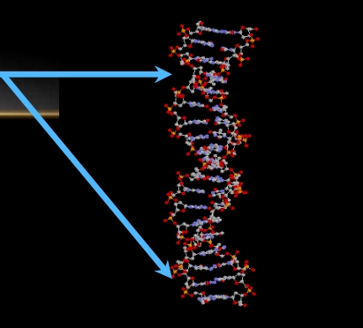
DNA ( DEOXYRIBO NUCLEIC ACID )
DNA is a double stranded molecule that is twisted into a Helix (Spiraling Staircase)
DNA Double Helix

Slide 19
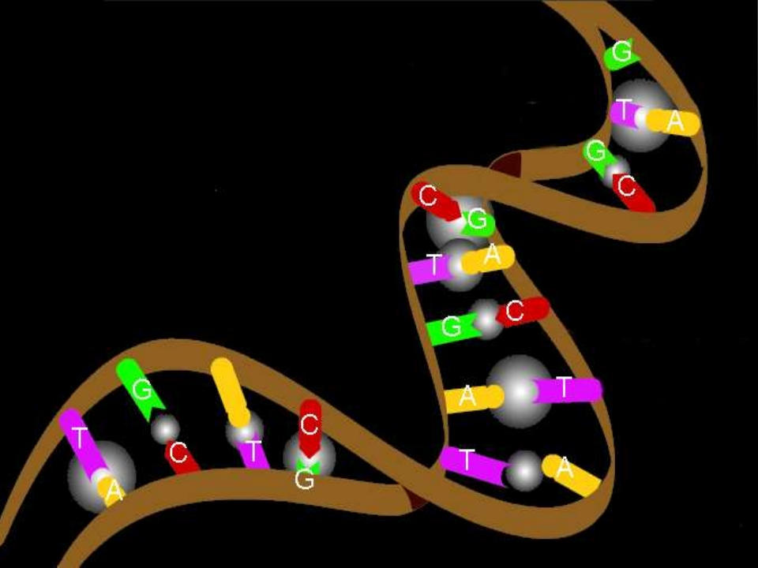
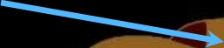
Each Strand consists of
1) A Sugar Phosphate Backbone

Slide 20
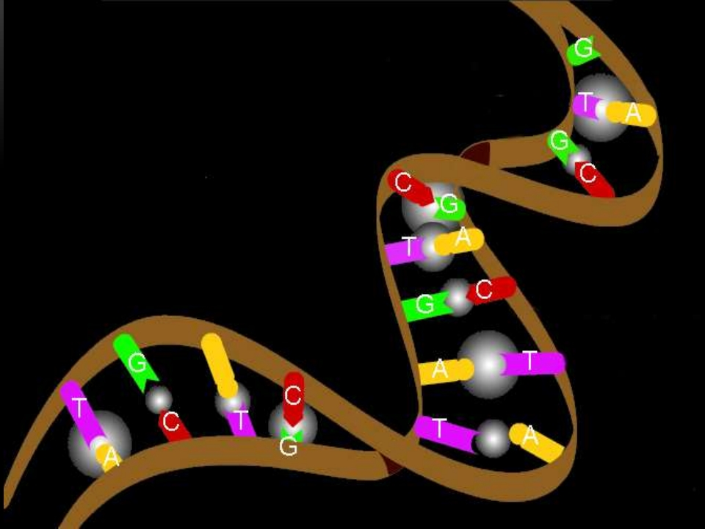
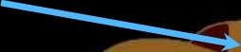
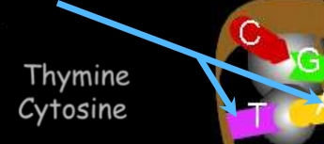
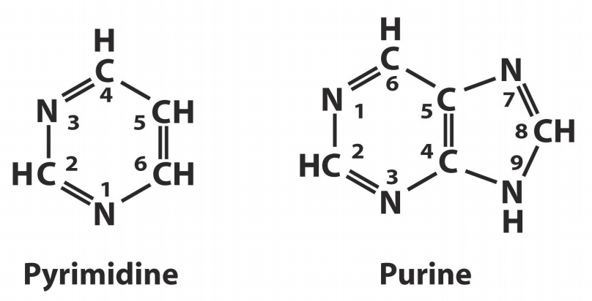
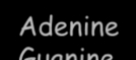
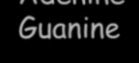
Each strand consists of:
Basic structure of
pyrimidine and purine
1) A Sugar Phosphate Backbone 2) Four Base Chemicals
(Attached in pairs)
Adenine pairs with Thymine
Guanine pairs with Cytosine
5

Slide 21
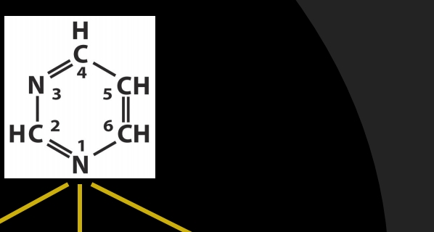
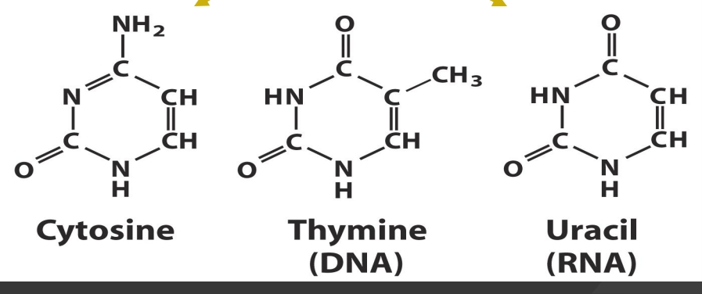
Pyrimidines
Biochemistry for Medics
6

Slide 22
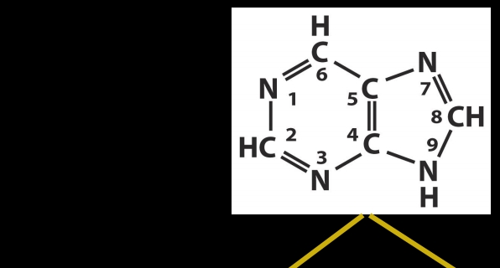
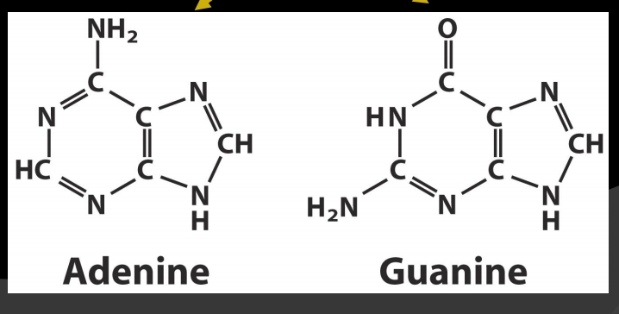
Purines
Biochemistry for Medics
7

Slide 23

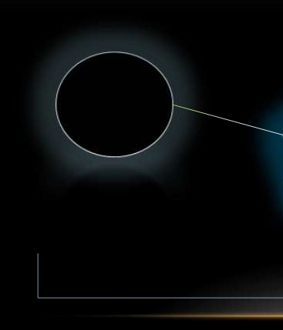
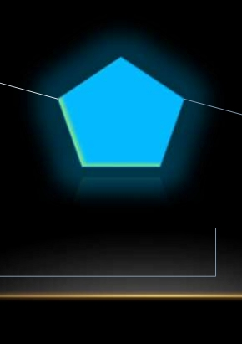
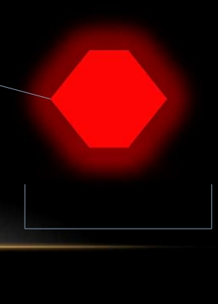
STRUCTURE
Basic structure of DNA is a sugar-phosphate backbone with 4 variable nitrogenous bases. This structure is called a nucleotide.
P
sugar
Nitrogen
base
Phosphate molecule:
HYDROPHILIC 5-carbon sugar:
DEOXYRIBOSE
Nitrogen base:
HYDROPHOBIC
BACKBONE BASE

Slide 24
Nomenclature of Nucleic Acid Components
Base Nucleoside Nucleotide Nucleic
acid
Purines
Adenine Adenosine Adenylate RNA
Deoxyadenosine Deoxyadenylate DNA
Guanine Guanosine Guanylate RNA
Deoxy guanosine Deoxyguanylate DNA
Pyrimidines
Cytosine Cytidine Cytidylate RNA
Deoxycytidine Deoxycytidylate DNA
Thymine Thymidine Thymidylate DNA
(deoxythymidine) (deoxythymidylate)
Uracil Uridine Uridylate RNA
Biochemistry for Medics
8

Slide 25
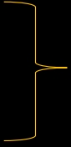
NUCLEIC ACIDS
▪
Nucleic acids are polymers
▪
Nucleotides are monomer
➢ Nitrogenous bases
• Purines
• Pyrimidine
Nucleosides
➢ Sugar
• Ribose
• Deoxyribose
➢
Phosphates + nucleoside = nucleotide

Slide 26
THE EARLY EFFORTS
• By the early 1900’s it was known that the chromosomes carry the genetic (hereditary) information
• Chromosomes consist of DNA (deoxyribonucleic acid)

Slide 27
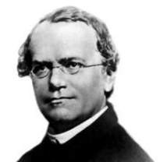
Gregor Mendel:
Introduces the concept of heredity
Mendel's Laws are as follows:
1. the Law of Dominance 2. the Law of Segregation 3. the Law of Independent Assortment
Pisum sativum – pea plant – what are the seven characters? Selected
1865
1909 1911
1929
1944
1950

Slide 28
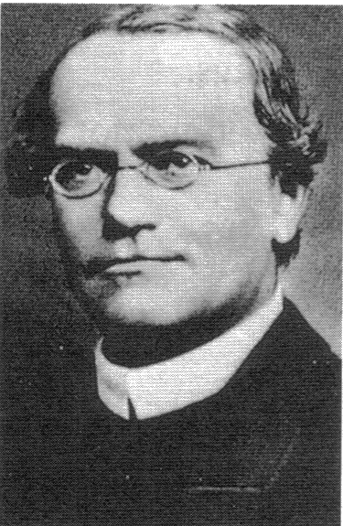
Gregor Mendel
• “Experiments in Plant Hybridization”, ca. 1865
Found a mathematical relationship between genotype and phenotype
Showed that traits are inherited in a predictable manner as “factors”
Provided a mechanism to drive evolution
Proposed that traits are determined by a pair of genes and hypothesized that the number of genes are cut in half during gametogenesis.

Slide 29
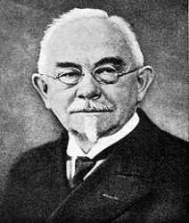
Wilhelm Johannsen:
Coins the term “Gene
1865
1909 1911
1929
1944
1950

Slide 30
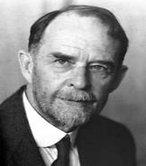
Thomas Hunt Morgan:
Discovers that genes are responsible for inheritance
Thomas Hunt Morgan (1910) began studying hereditary traits in fruit flies (Drosophila melanogaster)
Spatial arrangement of genes on chromosomes
Sex-linked traits
Crossing-over → distance between linked genes
Lead to Drosophila as one of the best-studied organisms in genetic research to this day.
1865
1909 1911
1929
1944
1950

Slide 31
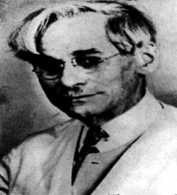
Phoebus Levene:
Discovers that DNA is made up of nucleotides, phosphates, sugars and 4 bases
1865
1909 1911
1929
1944
1950

Slide 32
Are Genes Physical Entities?
1914 – Robert Feulgen discovered a stain for nucleic acid. Could now quantify “nucleic acid”.
Gametes – half the staining of body cells.
1920s – Phoebus Levene identified four nitrogenous bases as well as a deoxyribose sugar and a phosphate group in nucleic acid.
• Hermann Müller (1926), a former member of Thomas Morgan's team, showed that exposure to X-rays can cause genetic mutations in Drosophila.
- shows the “information of life is a molecule”

Slide 33
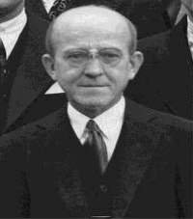
Oswald Avery:
Shows that DNA can transform the property of cells
However, this idea was not universally accepted
1865
1909 1911
1929
1944
1950

Slide 34
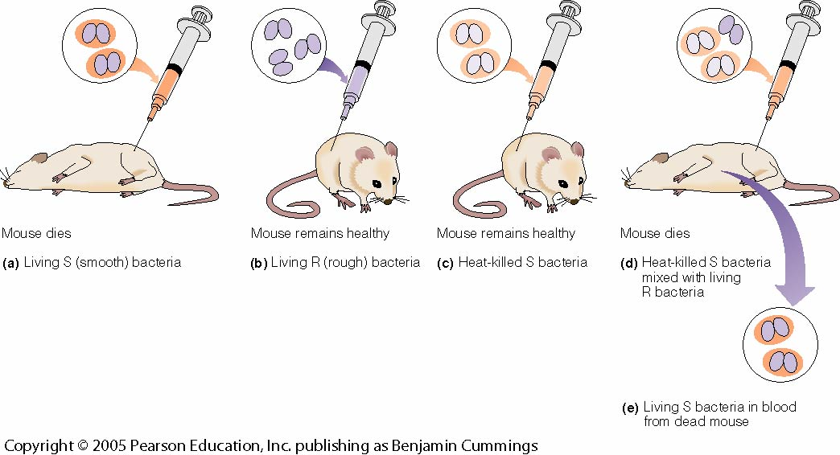
Fred Griffith (1928)
Griffith’s hypothesis: Streptococcus pneumoniae
some “principle” was transferred; the killed S strain converted the R strain to virulence by enabling it to synthesize a new polysaccharide coat.

Slide 35
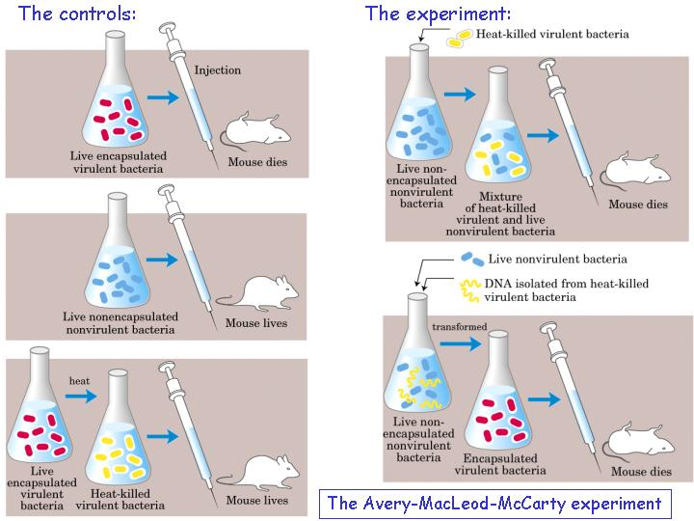
In 1944, Oswald Avery, Colin MacLeod, and Maclyn McCarty reported that they had found the “transforming principle”
DNA!

Slide 36
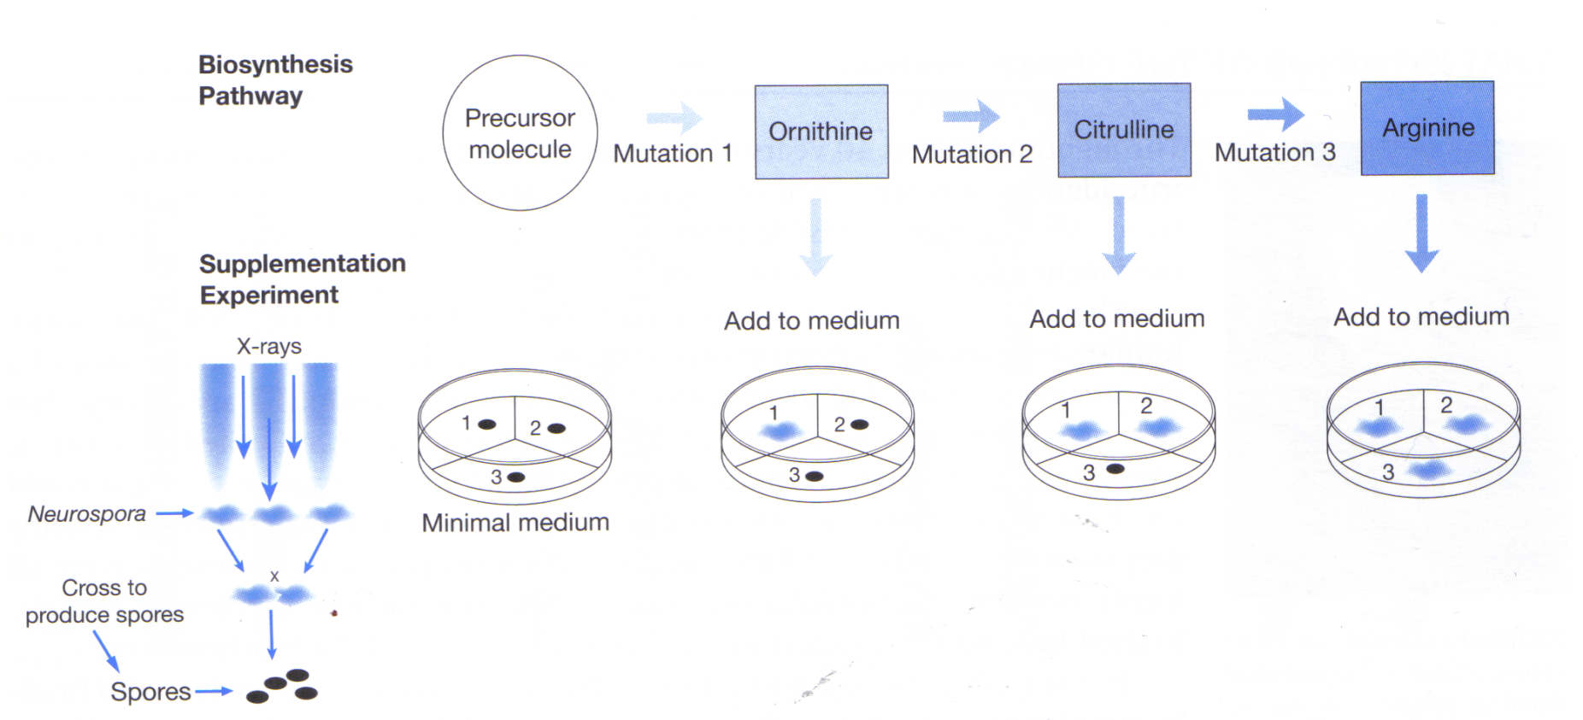
Further work by Beadle and Tatum in the 1940s with
the fungus Neurospora crassa showed that a single
mutation specifically ablated the activity of one enzyme.
Beadle and Tatum hypothesized that each of these mutations blocked a different step in the synthesis of arginine (“one gene/one enzyme”)

Slide 37
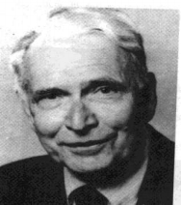
Erwin Chargaff:
Shows that: A + G = T + C = 50%
1865
1909 1911
1929
1944
1950

Slide 38
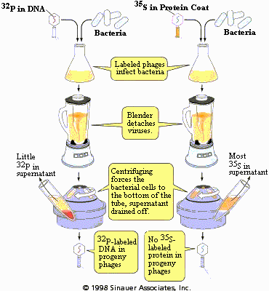
In 1952, Hershey and Chase make the connection between DNA and Heredity with their “Blender Experiment”
Evidence:
T₂ ₋Phage DNA remains with the bacterial cells.
Phage protein is in the supernatent.
Most of the initially infected
bacteria (in the cell pellet)
can produce phage.
If stirring is omitted, both protein and DNA sediment with the bacteria.
Phage protein = empty phage coats

Slide 39
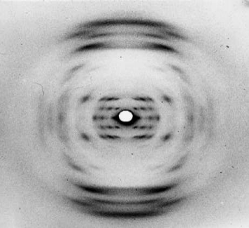
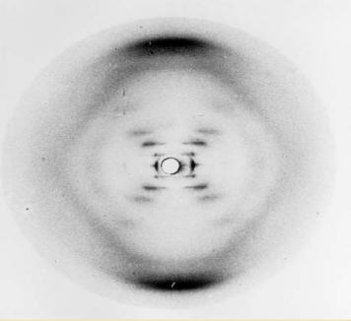
Franklin’s Work
Two Forms of DNA
In 1951 Rosalind Franklin discovers the Two Forms of DNA through her X-ray diffraction images (Wilkins).
A – Dry Form
B – Wet Form

Slide 40
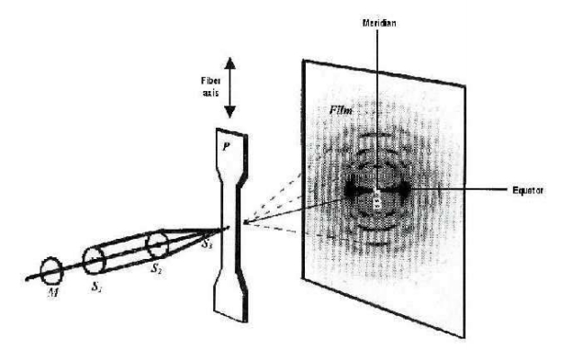
X- Ray Crystallography

Slide 41
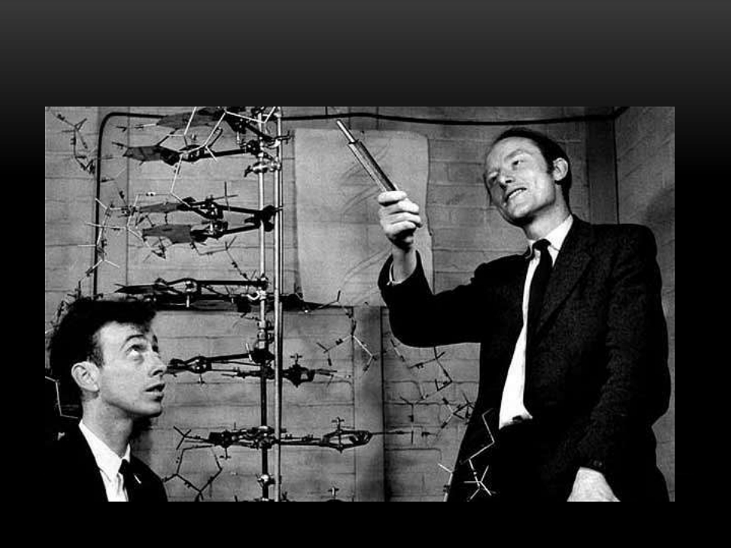
The Watson-Crick Model of the Structure of DNA

Slide 42
Linus Pauling
In the 1950's, Linus Pauling became known as the founder of molecular biology due to his discovery of the spiral structure of proteins (Taton, 1964). ... Pauling made it possible for geneticists to crack the DNA code of all organisms and develop techniques to help prevent the inheritance of genetic disorders

Slide 43
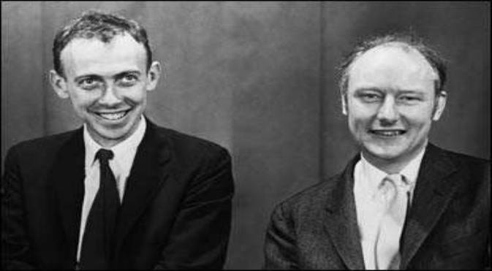
On Feb. 28, 1953, Francis Crick walked into the Eagle pub in Cambridge, England, and, as James Watson later recalled, announced that "we had found the secret of life." Actually, they had. That morning, Watson and Crick had figured out the structure of deoxyribonucleic acid, DNA. And that structure — a "double helix" that can "unzip" to make copies of itself — confirmed suspicions that DNA carries life's hereditary information .

Slide 44
Watson and Crick’s Work
• In 1951 James Watson traveled from the United States to work with Francis Crick at Cambridge University.
• Watson and Crick used the “Model Building” approach.
• They physically built models out of wire, sheet metal, nuts and bolts to come up with the structure of DNA.
Why did they build models?
“Sometimes the fingers can grasp what the mind cannot” (Biology the Science of Life)

Slide 45
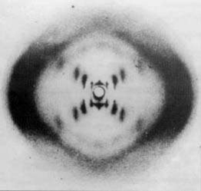
• DNA consists of two chains of nucleotides in a ladder-like structure which is twisted (Double Helix)
• Used data of M.H.F. Wilkins and Rosalind Franklin , early 50’s
• Wilkins and Franklin studied
the structure of DNA crystals
using X-rays.
• The X pattern suggested
the structure of DNA was a
helix.

Slide 46
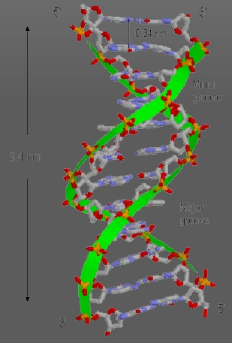
• Used data of Erwin Chargaff, 1940’s and early 50's
• Chargaff ’s Rule: His data showed that in each species, the percent of A equals the percent of T, and the percent of G equals the percent of C.
• Watson was shown this picture by Wilkins in early 1953.
From the picture it was possible to calculate: 1) the distance between bases (3.4A)
2) the length of the period (34A)
3) the rise of the helix (36 degrees)

Slide 47
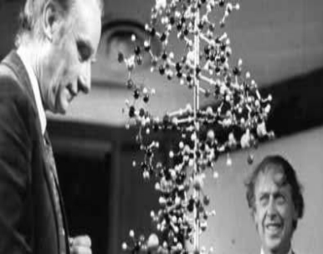
• Francis Crick and James Watson with Maurice Wilkins received the 1962 Nobel Prize for discovering the molecular
structure of deoxyribonucleic
acid (DNA).
• Widely regarded as one of the most important discoveries of the 20th century it has led the way to the mapping and deciphering of all the genes in the human chromosomes

Slide 48
Watson and Crick Model:
• The sides of the ladder are made up of alternating molecules of phosphate and deoxyribose.
• The bases make up the rungs of the ladder are attracted by a weak chemical bonds called hydrogen bonds.
• The DNA double helix is anti-parallel, which means that the 5' end of one strand is paired with the 3' end of its complementary strand (and vice versa).
• 5'--------------->3‘
3'<---------------5'
• Two hydrogen bonds connect T to A; three hydrogen bonds connect G to C.

Slide 49
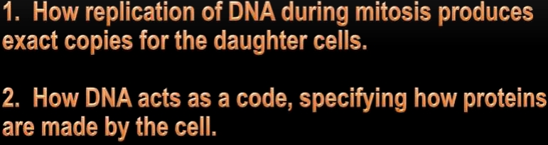

Slide 50
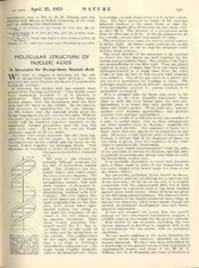
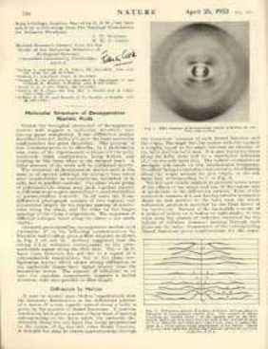
“Nature”
Watson & Crick quickly published their Scientific Journal called “Nature” on April 25 1953
th

Slide 51
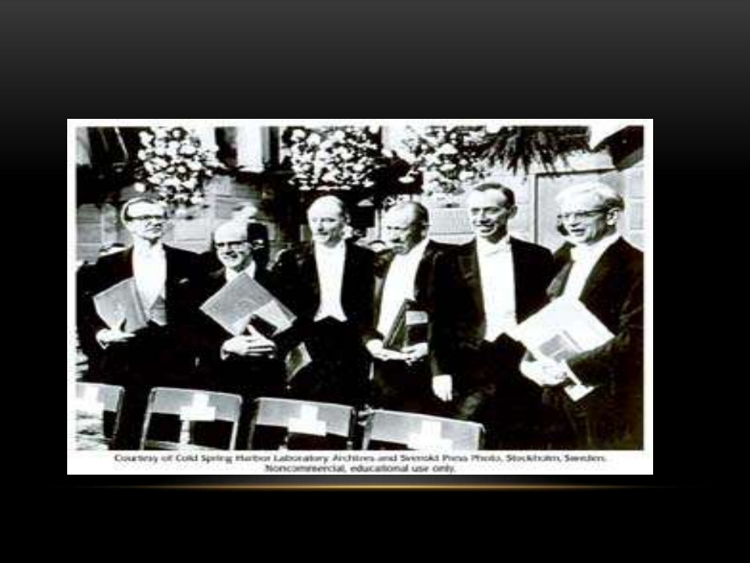
The Nobel Prize
• In 1962 Watson, Crick & Wilkins won the Nobel Prize for their discovery of the structure of DNA.

Slide 52
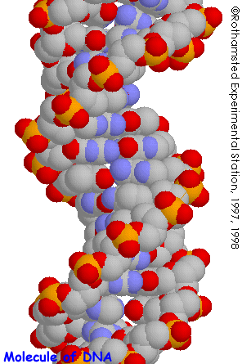


What is the Structure of the DNA Molecule?
James Watson and Francis Crick solve the puzzle in 1953!
Chargaff:
A = T, G = C
Rosalind Franklin’s X-ray
crystallography data provided
the dimensions
Levene:
Bases
Phosphate
Sugar

Slide 53

Double Helical Structure of DNA
Forms a right-handed helix.
The strands run antiparallel.
There are about 10 base pairs per turn of the helix.
One turn of the helix is 3.4 nm.
The base pairs are .34 nm apart.
Sugar phosphates on outside, base pairs on inside.
Major groove

Slide 54

OK, but what does DNA do?
Watson and Crick conclude:
“It has not escaped our notice that the specific pairing we have postulated immediately suggests a possible copying mechanism for the genetic material”.
• Besides copying, DNA must do
more if it is the genetic material
- It must code for traits
- There must be a mechanism by which
it gets expressed as traits

Slide 55











Slide 56

A-DNA
• A-DNA is one of the many possible double helical structures of DNA.
• It is most active along with other forms.
• Helix has left-handed sense, shorter more compact helical structure.
• It occurs only in dehydrated samples of DNA, such as those used in crystallographic experiments.

Slide 57
Structure
• A-DNA is fairly similar to B-DNA.
• Slight increase in the number of bp/ rotation (resulting in a tighter rotation angle), and smaller rise/turn.
• deep major groove and a shallow minor groove.
• Favoured conformation at low water concentrations.
• In a solution with higher salt concentrations or with alcohol added, the DNA structure may change to an A form, which is still right-handed, but every 2.3 nm makes a turn and there are 11 base pairs per turn.

Slide 58
Function
• A transition from B-DNA to A-DNA occurs during Transcription.
A-DNA also plays a imp role in some processes that do not involve RNA.
For Example:
• In sporulating bacteria, there is a protein which can bind to DNA in the B-conformation & induce a change to the A-DNA helix
• Also, Long terminal repeats (LTRs) of transposable elements, these regions often contains purine stretches which favour the A-DNA conformation.

Slide 59




B-DNA
• Most common DNA conformation in vivo.
• Favoured conformation at high water concentrations.
• Also known as Watson & Crick model of DNA.
• First identified in fibre at 92% relative humidity.
The B-DNA structure

Slide 60
Structure
• Narrower, more elongated helix than A.
• Wide major groove easily accessible to proteins & Narrow minor groove.
• Base pairs nearly perpendicular to helix axis
• One spiral is 3.4nm or 34Ǻ.
• Distance between two H-bonds is 0.34nm or 3.4Ǻ.

Slide 61

Z-DNA
• Z-DNA is one of the many possible double helical structures of DNA.
• Helix has left-handed sense.
• It is most active double helical structure.
• Can be formed in vivo, given proper sequence and super helical tension, but function remains obscure.

Slide 62
Structure
• Z-DNA is a transient form of DNA.
• Narrower, more elongated helix than A or B.
• Z-DNA was first discovered in 1979,certain proteins bind very strongly to Z-DNA.
• Z-DNA plays an important biological role in protection against viral disease.
• One turn spans 4.6 nm, comprising 12 base pairs.
• The DNA molecule with alternating G-C sequences in alcohol or high salt solution tends to have such structure.

Slide 63

Function
• While no definitive biological significance of Z-DNA has been found, it is commonly believed to provide torsional strain relief (supercoiling) while DNA transcription occurs.
• Toxic effect of ethidium bromide on ttrypanosoma is caused by shift of their kinetoplastid DNA to Z-form.
• Scientists have since discovered that certain proteins bind very strongly to Z-DNA, suggesting that Z-DNA plays an important biological role in protection against viral disease.

Slide 64

Direction of Helix

Slide 65

The helix axis of A-, B-, and Z-DNA.
Helix sense : Right-handed Right-handed Left-handed
Bp/turn
: 11 10 12
Diameter :
23Ǻ 20Ǻ 18Ǻ
Axial rise(nm) : 0.26 0.34 0.45

Slide 66
Factors involved for different DNA conformations :
There are at least three factors on which the DNA conformation depends
1) Ionic or hydration environment
2) DNA sequences.
3) Presence of specific proteins
In a living cell, DNA is a Mixture of A-& B-DNA conformation with a few regions capable of forming Z-DNA

Slide 67

Nucleoside and base analogs can be
used as anti-cancer and anti-virus drugs
Anticancer agents
5-Fluorouracil 6-Mercaptopurine
Antiretroviral agents
Azidothymidine Dideoxyinosine
Biochemistry for Medics
9

Slide 68
DNA structure
➢
Primary structure
➢
Secondary structure
➢
Tertiary structure
Biochemistry for Medics
10

Slide 69

The primary structure of
DNA is the sequence
5’ end
5’
3’
Phosphodiester
linkage
3’ end
Biochemistry for Medics
11

Slide 70

Traditionally, a DNA sequence is drawn from 5’ to 3’ end.
A shorthand notation for this sequence is ACGTA
Biochemistry for Medics
12

Slide 71

The secondary structure of DNA is the double helix
Biochemistry for Medics
13

Slide 72

The secondary structure of
DNA
Two anti-parallel polynucleotide chains wound around the same axis.
Sugar-phosphate chains wrap
around the periphery.
Bases (A, T, C and G) occupy the core, forming complementary A · T and G · C Watson-Crick base pairs.
Biochemistry for Medics
14

Slide 73
The DNA double helix is held together mainly by- Hydrogen bonds
➢
hydrogen bonding;
➢
base stacking
Biochemistry for Medics
15

Slide 74

Hydrogen bond
a chemical bond in which a hydrogen atom of one molecule is attracted to an electronegative atom, especially a nitrogen, oxygen, or fluorine atom, usually of another molecule.
Biochemistry for Medics
16

Slide 75

Two hydrogen bonds between A:T pairs Three hydrogen bonds between C: G paired
Biochemistry for Medics
17

Slide 76

Base Stacking
The bases in DNA are planar and have a
tendency to "stack".
Major stacking forces:
➢hydrophobic interaction ➢van der Waals forces.
Biochemistry for Medics
18

Slide 77
Structural forms of DNA
Property
A-DNA
B-DNA
Z-DNA
Helix
Right
Right
Left
Handedness
Base Pairs per
11
10.4
12
turn
Rise per base
0.23nm
0.34nm
0.38nm
pair along axis
Pitch
2.46nm
3.40nm
3.7 nm
Diameter
2.55nm
2.37nm
1.84nm
Conformation of
Glycosidic bond
anti
anti
Alternating anti
and syn
Major Groove
Present
Present
Absent
Biochemistry for Medics
19

Slide 78

Normally hydrated DNA: B-form DNA
Helical sense: right handed
Base pairs: almost
perpendicular to the helix
axis; 3.4 Å apart
One turn of the helix: 36 Å; ~10.4 base pairs
Minor groove: 12 Å across Major groove: 22 Å across
Biochemistry for Medics
20

Slide 79
In eukaryotic cells, DNA is folded into chromatin
Biochemistry for Medics
21

Slide 80


Complementary base pairing:
G-C and A-T
DNA Packing:

Slide 81
DNA Tertiary Structure
•DNA DOUBLE HELICAL STRUCTURE COILS ROUND HISTONES.
•DNA BOUND TO HISTONES FORM S NUCLEOSOMES (10nm FIBRES)
•NUCLEOSOMES CONTAIN 146 NUCLEOTIDES
Biochemistry for Medics
22

Slide 82

Nucleosomes
any of the repeating globular subunits of chromatin that consist of a complex
of DNA and histone
Biochemistry for Medics
23

Slide 83


Structure of nucleosome core
Biochemistry for Medics
24

Slide 84

Compaction of DNA in a eukaryotic chromosome
Biochemistry for Medics
25

Slide 85

Supercoil = coil over coil
Biochemistry for Medics
26

Slide 86
DNA melting and annealing
Biochemistry for Medics
27

Slide 87


Reversible denaturation and annealing of DNA
Biochemistry for Medics
28

Slide 88

Melting point ( tm) of DNA
The temperature at the mid-point of the transition
Biochemistry for Medics
29

Slide 89

The tm of DNA depends on:
➢
Content of G·C base pairs size of DNA
➢
➢
pH
➢
ionic strength
Biochemistry for Medics
30

Slide 90
Functions of DNA and
summary of structure
DNA consists of four bases—A, G, C, and T—that are held in linear array by phosphodiester bonds through the 3' and 5' positions of adjacent deoxyribose moieties.
DNA is organized into two strands by the pairing of bases A to T and G to C on complementary strands. These strands form a double helix around a central axis.
The 3 x 10 base pairs of DNA in humans are organized into the haploid complement of 23 chromosomes.
9
DNA provides a template for its own replication and thus maintenance of the genotype and for the transcription of the roughly 30,000 human genes into a variety of RNA molecules.
Biochemistry for Medics
31

Slide 91




